Slide 1
Class 7
Mini Presentations - part 2
28.5.2017

Slide 2
Dropout
Aviv & Daniel

Slide 3
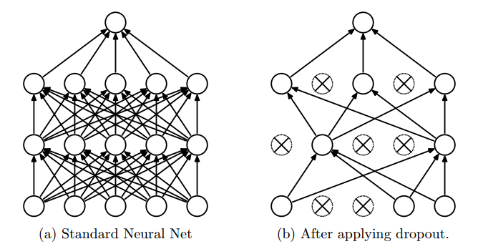
Dropout - general
What is Dropout?
  Keep neuron's output with some probability (use for some or all layers)
Why use dropout? – reduces overfitting
  Net learns multiple independent representations of same data
  Prevents complex co-adaptations

Slide 4

Dropout - code
Dropout parameters
  keep_prob: train (p=0.5-0.8) vs. test (p=1)
Other parameters
  increase learning rate by factor of 10-100
  use high momentum value: 0.9 or 0.99
Best use when overfitting

Slide 5
Intro to Keras
Gal & Gal

Slide 6
Introduction to Keras
Gal Benor, Gal Yona

Slide 7
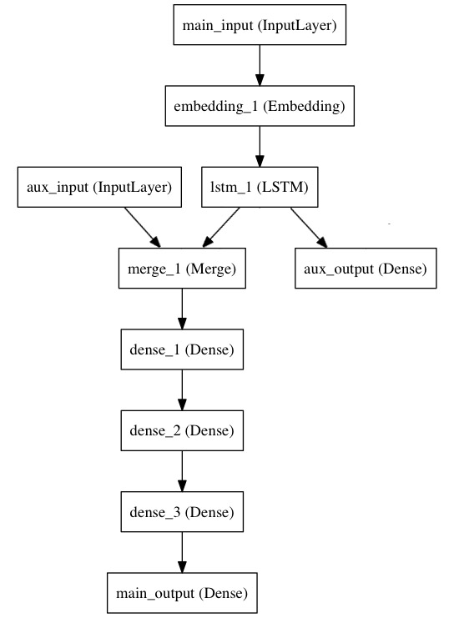
Using Keras - Motivation
Keras is a high-level neural networks API, written in Python that works on top of either TensorFlow or Theano as its backend.
Core data structure of Keras is a model, which is just a way to organize layers.
  There are two ways Keras offers us to model our network:
The model’s layers are a way of representing the neural network in a simple and manageable way.
.
Sequential model
Linear stack of layers
Keras functional API
Arbitrary graphs of layers

Slide 8
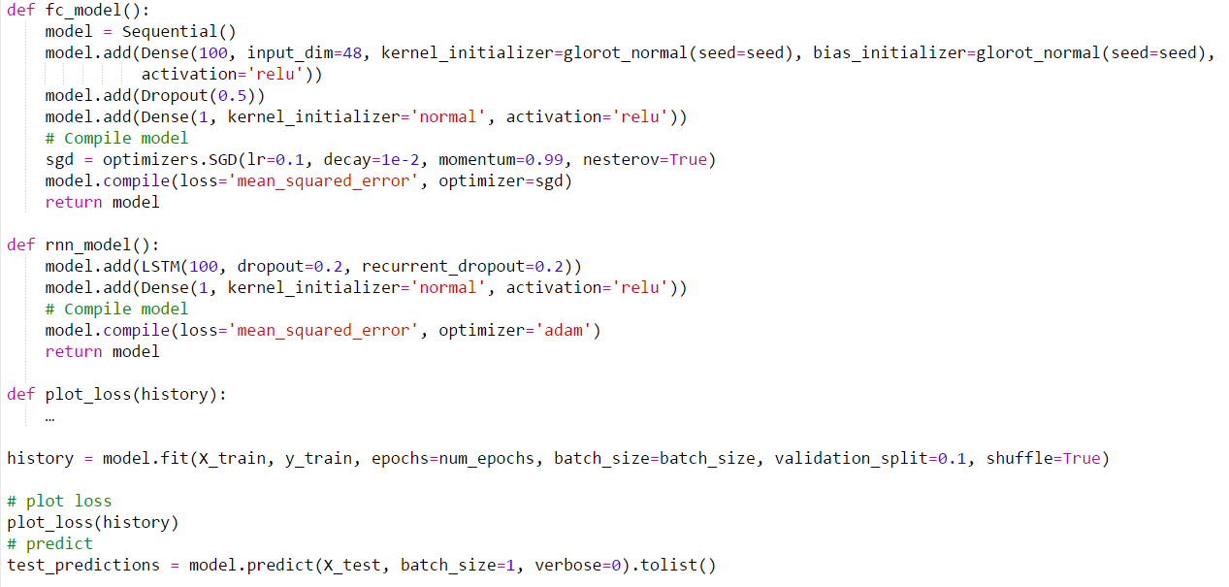
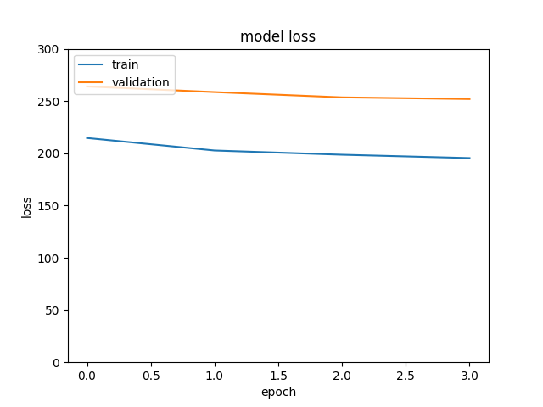

Slide 9
Intro to Keras 2
Yotam Amar

Slide 10
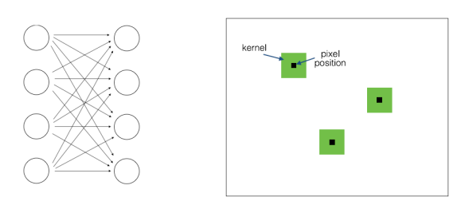
Locally Connected Layer
It’s a mid-point between fully connected and convolution
Is = input size
Ic = input channels
k = kernel size
Os = output size
Oc = output channels
Fully connected
Is×Ic×Os×Oc
convolution
Ic×k×Oc

Slide 11
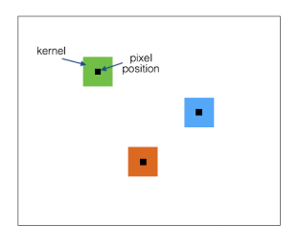
Locally Connected Layer
It’s a mid-point between fully connected and convolution
Is = input size
Ic = input channels
k = kernel size
Os = output size
Oc = output channels
Locally Connected
Is×Ic×k×Oc

Slide 12
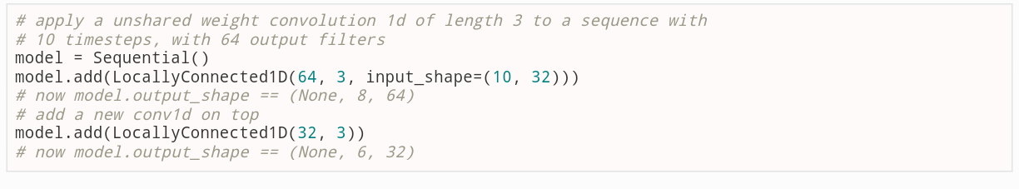
Locally Connected Layer
Keras implimantation:
Just replace Conv1D with LocallyConnected1D (2D also available)
keras.layers.local.LocallyConnected1D(filters, kernel_size, strides=1, padding='valid', data_format=None, activation=None, use_bias=True, kernel_initializer='glorot_uniform', bias_initializer='zeros', kernel_regularizer=None, bias_regularizer=None, activity_regularizer=None, kernel_constraint=None, bias_constraint=None)

Slide 13
Residual Networks
Lee Peleg

Slide 14
Residual Networks
Lee Peleg

Slide 15
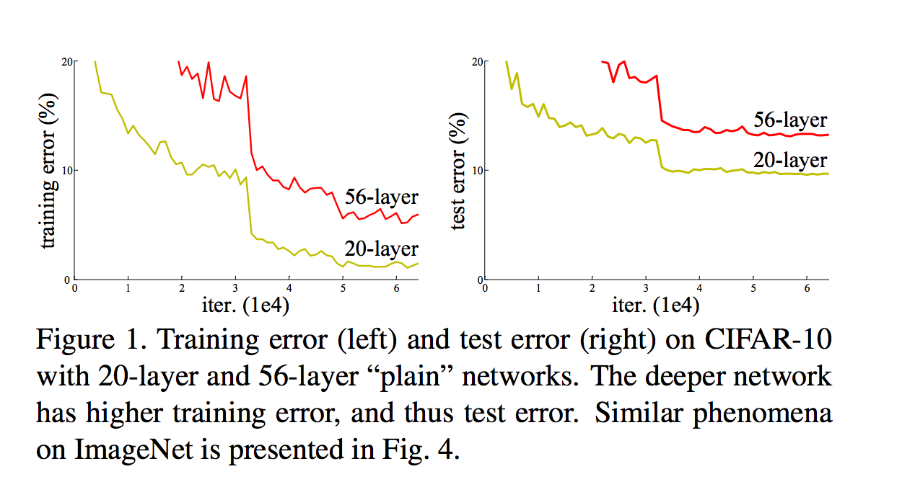
Motivation
Deeper network perform better on image recognition tasks.
When reaching tens of layers, a degradation suddenly appears for the training error.
But why would a deeper network ruin the training error, when it can just learn an identity representation?

Slide 16
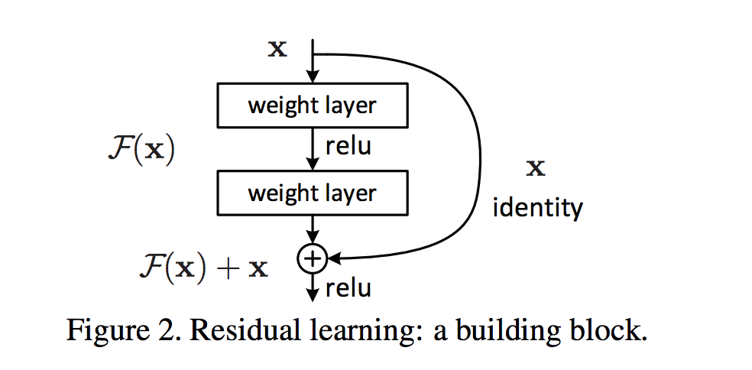

Scheme
The representation to be learned:
The residual representation can be built out of several non-linear layers.
For only one linear layer no advantage is observed
Dimensionality reduction through linear mapping:

Slide 17
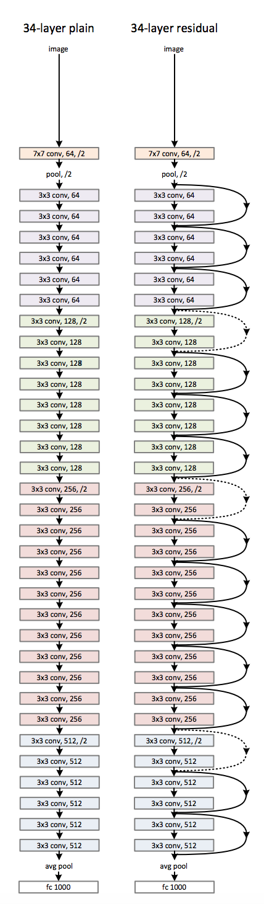
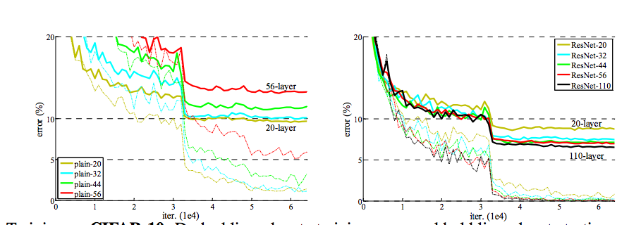
Tensorflow Implementation
def residual(name, l, increase_dim=False, first=False):
… %Stuff
with tf.variable_scope(name) as scope:
b1 = l if first else BNReLU(l)
c1 = Conv2D('conv1', b1, out_channel,
                stride=stride1, nl=BNReLU)
c2 = Conv2D('conv2', c1, out_channel)
l = c2 + l
      return l
Plain
Vs.
ResNet

Slide 18
Gradient Clipping
Hagai & Yonatan & Omer

Slide 19
Gradient clipping
Omer Shabtai

Slide 20
The problem
Context
Prone nets:
the exploding gradients problem refers to the large increase in the norm of the gradient during training
Happens for strong long-term correlations.
The opposite of vanishing gradient problem.
Many layered nets (deep)
RNN where back prop might extend to far past

Slide 21
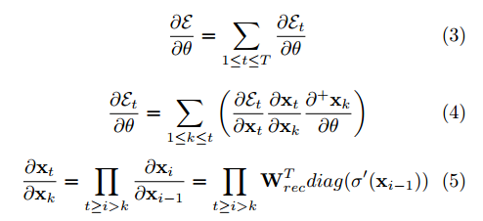
RNN back propagation:
Vanishing for max eigenvalue < 1
Exploading for max eigenvalue > 1

Slide 22
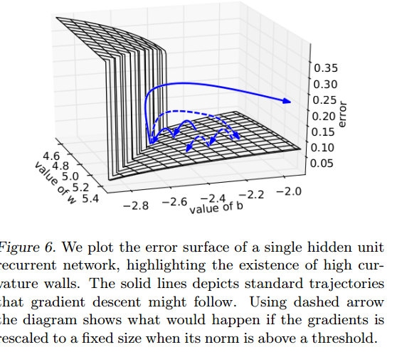
Solution- Gradient clipping

Slide 23
Implementation

Slide 24
Tensorflow built in functions:
Value clipping doesn’t keep gradient direction!
Basic (Value clipping):
tf.clip_by_value(t, clip_value_min, clip_value_max, name=None)
clip_value_max
clip_value_min

Slide 25
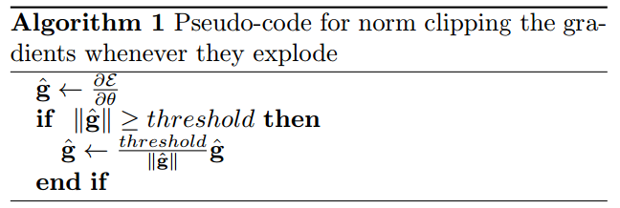
Norm - clipping

Slide 26
Advanced (L2 norms):
Typically used before applying an optimizer.
Resemble regularisation parameters, but allows long term memory.
tf.clip_by_norm(t, clip_norm, axes=None, name=None)
(over single layer, single gradient matrix)
tf.clip_by_average_norm(t, clip_norm, name=None)
(over gradient ensemble)

Slide 27
When applied on tensor list:
tf.clip_by_global_norm(t_list, clip_norm, use_norm=None, name=None)
This is the correct way to perform gradient clipping
slower than clip_by_norm() (needs all parameters)

Slide 28
Further reading
On the difficulty of training Recurrent Neural Networks: https://arxiv.org/pdf/1211.5063.pdf
Gradient clipping in Tensor flow: https://www.tensorflow.org/versions/r0.12/api_docs/python/train/gradient_clipping

